Slide 1
Team Immortals
Fire Department Project

Slide 2
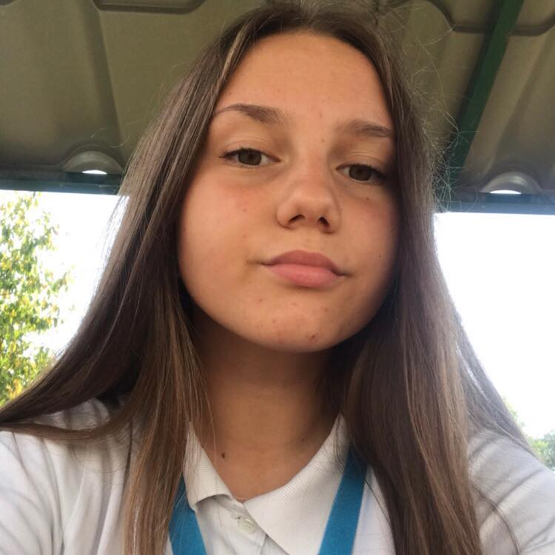
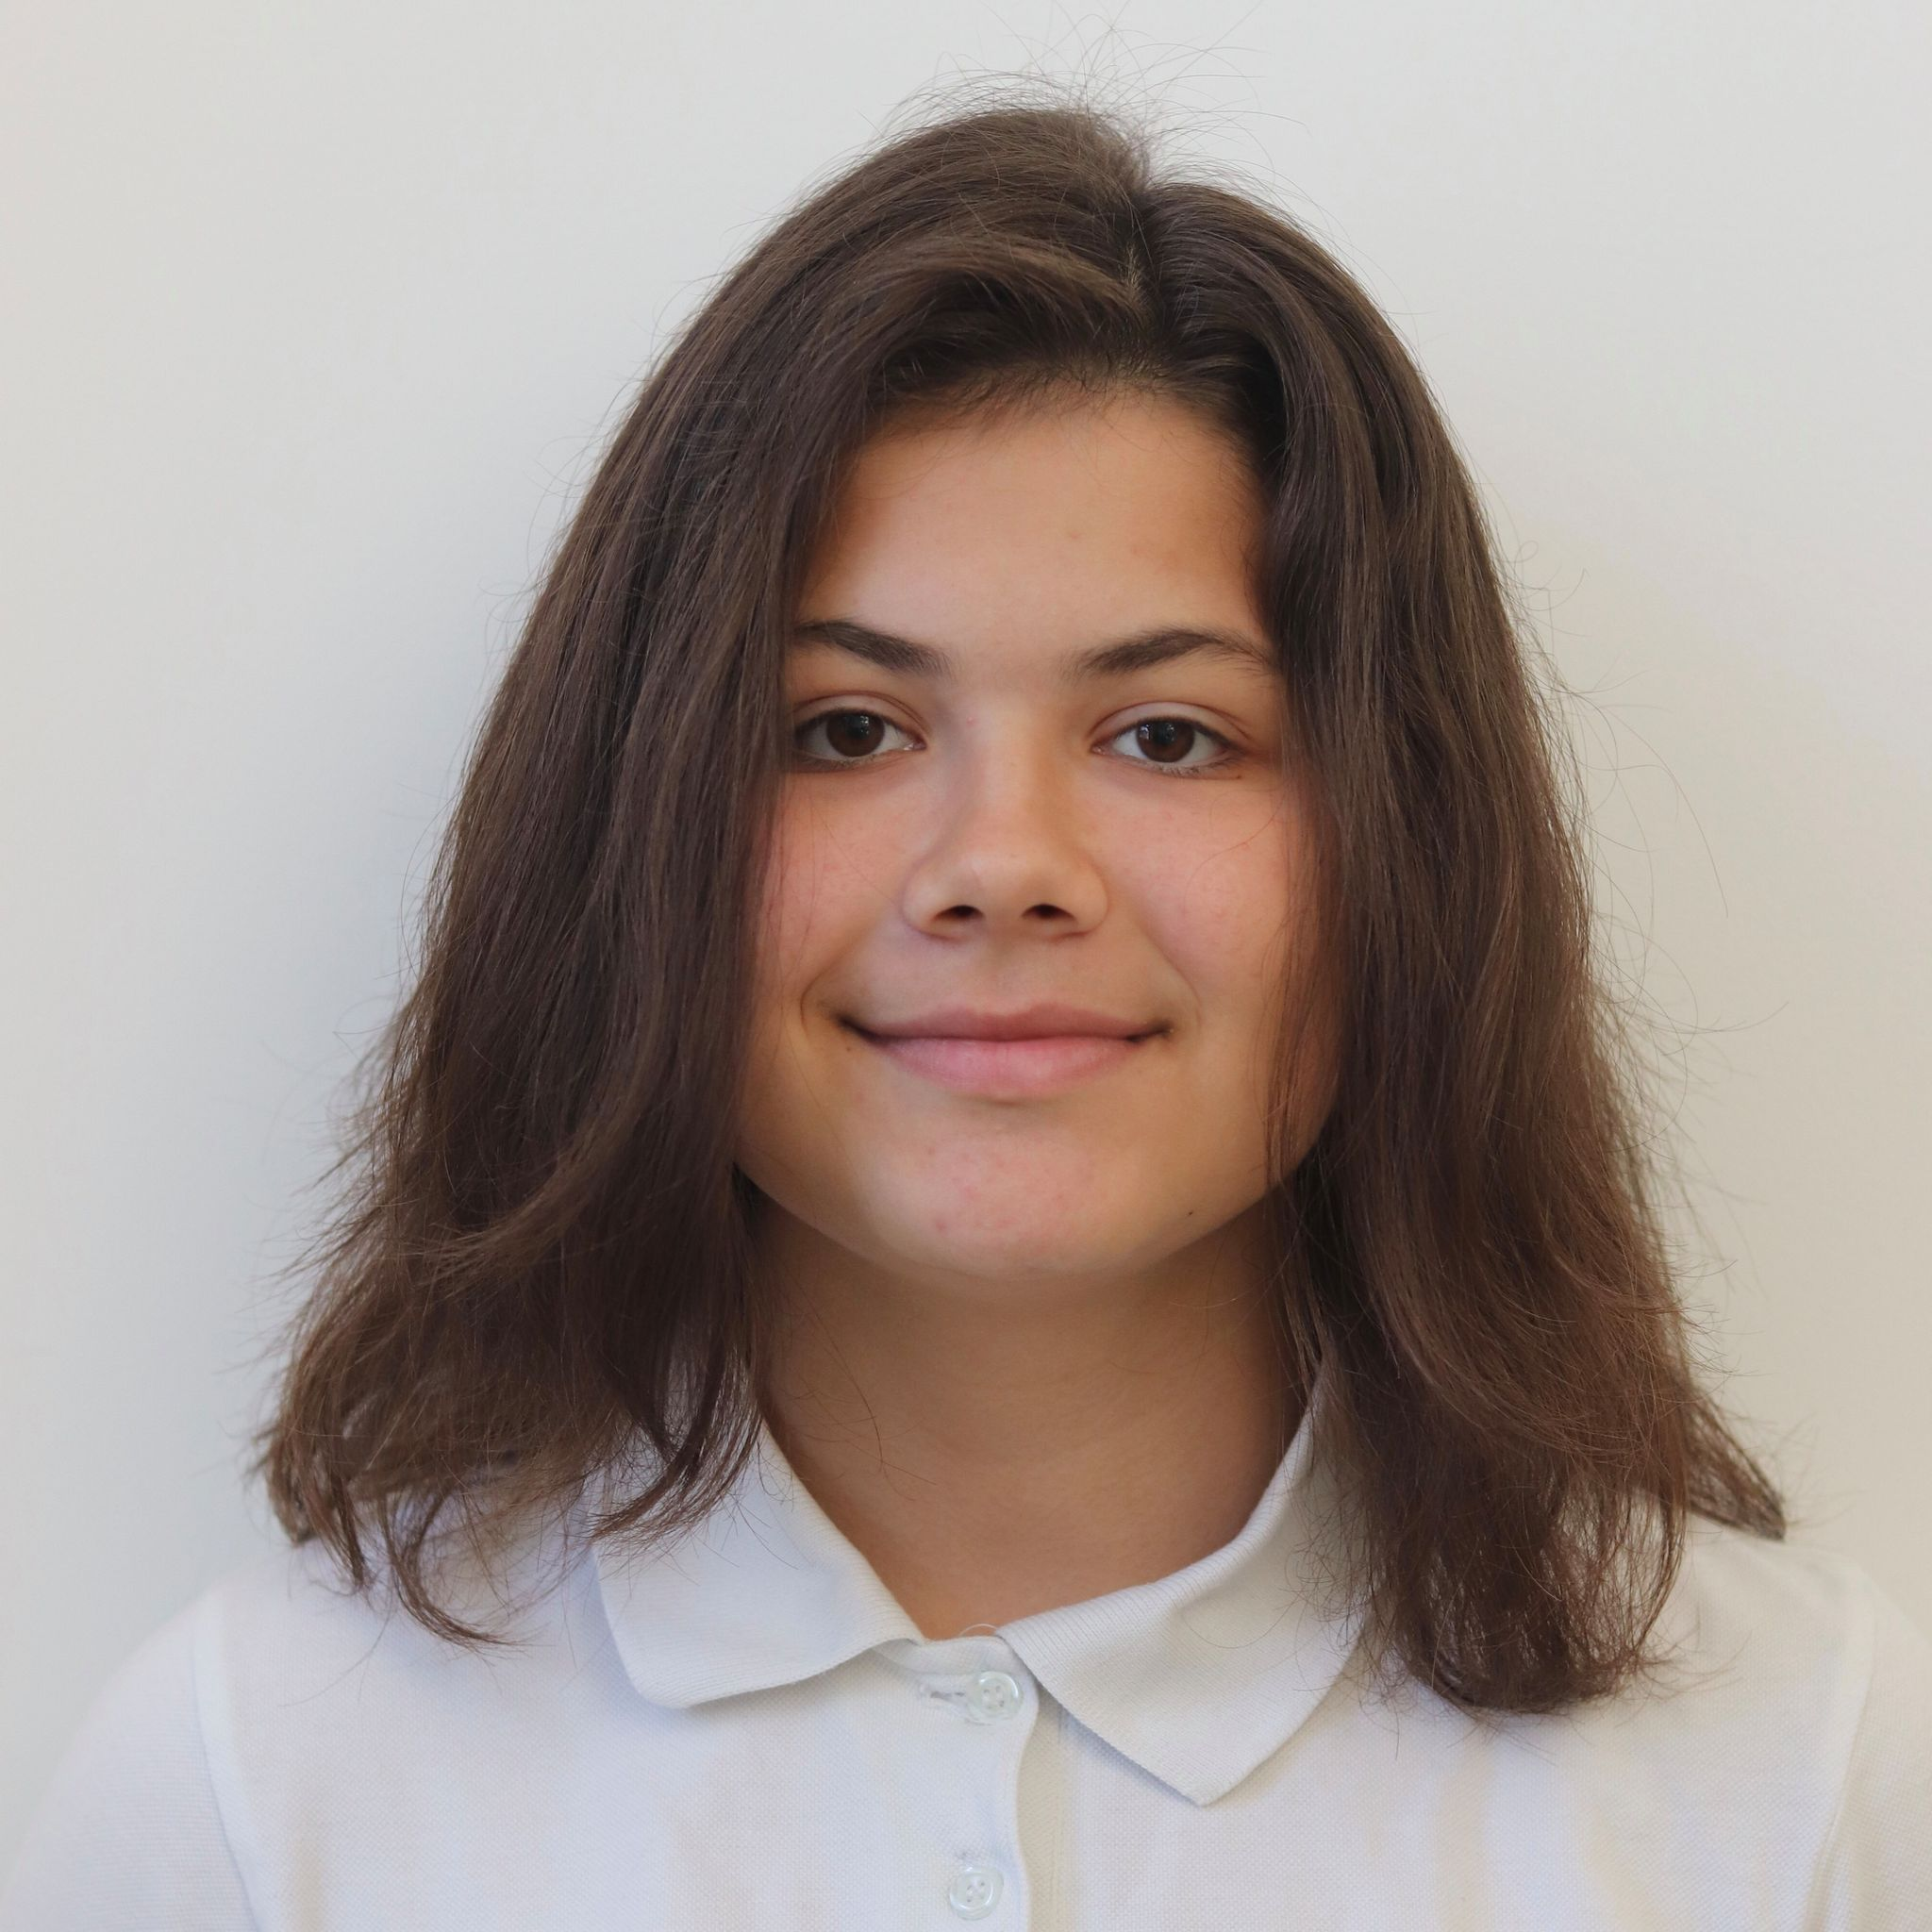
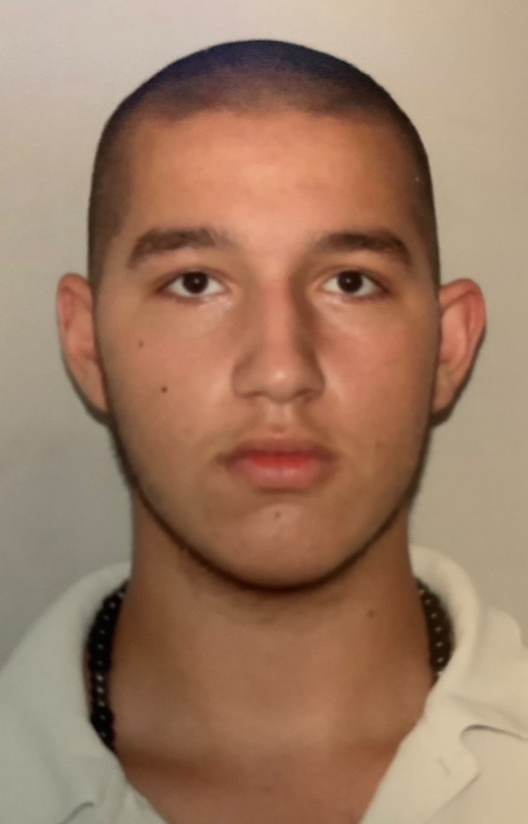
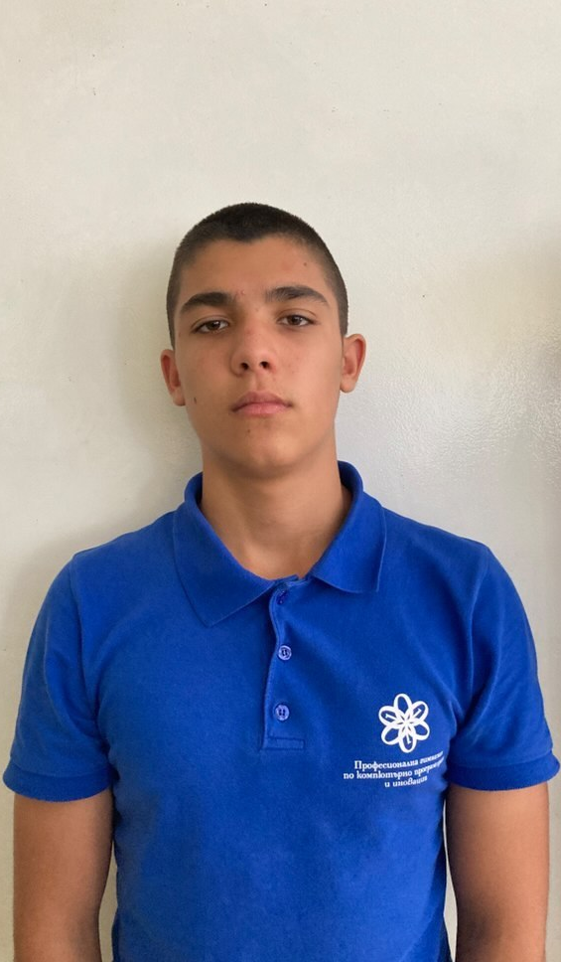
Our team
Karina Tangardzhieva IX g
Yoana Agafonova
IX v
Lubomir Bozukov
IX a
Yoan Dimitrov
IX b

Slide 3
Stages of realization
01
02
03
Discussion
Working
Presenting

Slide 4







Used technologies
1
2
3
4

Slide 5

Now it’s time to show you our site!

Slide 6
Thank you for your attention!

